Slide 1
Cognition and Its Structure

Slide 2
Cognition as a subject of philosophical analysis
The branch of philosophy that studies the cognitive process is called epistemology. This concept was introduced into philosophy for the first time in 1854 by the Scottish J. Ferrer. Studying the essence, structure and methods of the process of understanding the world is primarily included in the subject of philosophy.

Slide 3


Slide 4
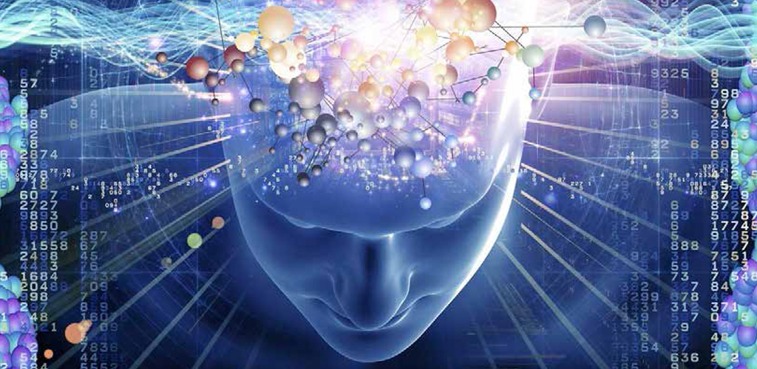
The object and subject of cognition
Individual people (individuals as well as social groups) and society as a whole can act as the subject of cognition. When the subject of cognition is individual, then the consciousness and self-awareness of that individual (personal "I") is determined by the entire cultural world created throughout human history. Successful cognitive activity is possible due to the active role of the subject in the false cognitive process.

Slide 5
The Object of Cognition
The object and subject of perception are inseparable
Cognitive object is the subject's practical and cognitive activity. An object is neither matter nor objective reality. The object of cognition can be both material entities (chemical elements, physical bodies, living organisms) and social phenomena (society, mutual relations of people, their behavior and activities). The results of cognition (the conclusion of the experiment, scientific theories, science as a whole) can also be the object of cognition. Thus, things, events, processes, etc. that exist independently of man can be considered an object of cognition.

Slide 6
The structure of the cognitive process
Sensory Perception
Rational Cognition

Slide 7

Cognition has the following forms: sensation, perception, imagination and emotion
Modern science proves that sight and hearing are in the first place among the sensory organs in terms of the ability of information .
perception is a relatively high form of cognition. It expresses the whole image of the objects that affect our sense organs at a specific moment, unlike the feeling.
This form of cognition, which stores the images of past events and can revive them when necessary, is called imagination .

Slide 8
Forms of Rational Cognition: Understanding, Judgment, and Inference
A concept is a form that reflects the most general, important and necessary properties of an object.
Judgment reflects the properties of the subject in the human mind, its connections and relationships with other subjects.
mental operation through which new knowledge is obtained based on already existing knowledge.

Slide 9
Theory of Truth
The issue arises of determining the compatibility between knowledge and objective world events is called truth in philosophy .
A classical (correspondence) theory of truth. When determining the authenticity of a certain idea, it is based on whether it corresponds to reality or not.

Slide 10


Slide 11
There are three types of objective truth: everyday, axiological and praxeological
The first part is related to material and spiritual life. In this case, the everyday life of people acts as an objective reality. In this way, the truth has its own characteristics.
The axiological distribution of truth shows its moral-ethical and aesthetic side, its close connection with the meaning of life and values.
The praxeological distribution of truth means that it includes a moment related to practice.

Slide 12
The Criterion of Truth is practice
Its content is objective and independent of consciousness. It connects a person with that objective reality. Finally, in the process of practice, people change objects.

Slide 13
Lies and Misrepresentations
Attention should also be paid to the relationship between truth and falsehood. Delusion is an inadequate perception of reality. Errors can be scientific and non-scientific.
A lie is a distorted perception of reality. Its cognitive content does not correspond to reality. An unintentional lie often corresponds to a fallacy, which may contain certain moments of objective truth.

Slide 14
Thanks for watching

