Slide 1
The problem of consciousness in philosophy

Slide 2
PLAN :
1 . The problem of consciousness in philosophy
2. The origin of consciousness. Forms and levels of reflection
3. The structure of consciousness. Self-consciousness

Slide 3
Consciousness is a person's companion in mastering the world. In order to enter the world of consciousness, it is not enough simply think, be excited, feel, perceive; for this, some kind of additional acts are necessary, I do not simply know something, but "I know that I know", etc.
Consciousness is a special condition unique to a person, with which the world and at the same time the person himself is understandable. Consciousness - instantly connects what a person sees, hears, feels, thinks and experiences. Many philosophers define consciousness as the wonder of wonders of the world, the greatest and divine gift revealed to man. "I" is the one who rises to the highest peak of spiritual existence. Here is suffering and love, friendship, joy, etc. feelings play an important role. Consciousness is not only a wonder of the world, but also a pain and torture.

Slide 4
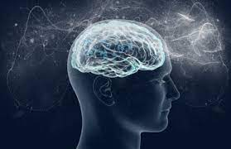
In the history of philosophical ideas, the problem of consciousness has two levels of its solution :
The first concerns the description of the ways in which things are brought to consciousness and exist there. In philosophical language, this consciousness is the description of the phenomenon.
Second, it aims to explain the possibility of consciousness itself, or more precisely, the phenomenon itself. The levels shown in ancient and modern philosophy were not distinguished, so it was considered that if the methods of existence of things in consciousness were described, then the question of the nature of consciousness was solved. In the 20th century, philosophers began to emphasize the possibility of the independence of consciousness.

Slide 5
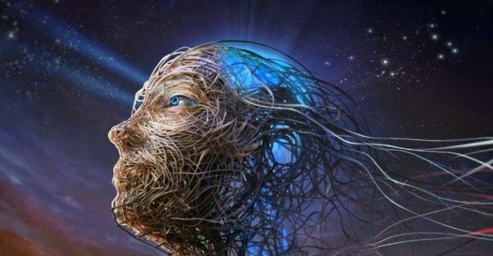
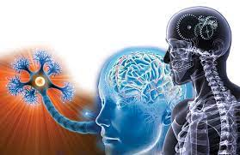
In the history of philosophy, there have been many different positions and concepts regarding consciousness. Materialistic concept believed that consciousness is the result of long-term evolution of matter. Matter, nature has always existed, and man appeared later. Consciousness is a property and product of the highly developed manifestation of matter, the human brain.
Sophists, especially Socrates , for the first time in the history of philosophy put forward the idea of distinguishing material and ideal, things and ideas. Plato, on the other hand, set the special "World of Ideas" against the "Material World" and considered the first to be decisive.

Slide 6
Some philosophers belonging to the materialism of the 18th century (B. Spinoza etc. ) called consciousness an attribute of matter, its eternal property inherent in all forms and types of its manifestation. They believed that not only living beings, not the brain, but all material world objects are conscious, they have the ability to think. This view is called "hylozaism" in the history of philosophy ("hilo" is Greek for object, substance, and "zoil" means life, consciousness).
Theories of Consciousness:
The 19th century, the position of vulgar materialism related to the name of physiologists-naturalists such as K. Vogt, L. Büchner and Y. Moleshott was. Supporters of that view considered consciousness to be material, like the brain, and materialized and equated both of them. They said that the brain secretes consciousness just as the liver secretes bile.
At the beginning of the 20th century, the founders of empiriocriticism (criticism of experience) , E. Max and R. Avenarius , did not accept the idea that consciousness and emotion are products of the brain. However, they fell into idealism by considering both "me" and the environment as consisting of "emotional complexes". According to them, in one case, all objects are "emotional complexes", the brain is also. Putting "emotional complexes" at the basis of everything is "pure idealism".

Slide 7
Consciousness did not suddenly emerge ready-made. It is the result of a long evolution. The separation of man from the animal world and labor play an important role in the creation of consciousness. There are a number of complex issues regarding the origin of consciousness. The first of them is how consciousness arises from matter. After all, as it was said above, consciousness appeared at a certain stage of the development of matter. It is appropriate to start the explanation of this process from the concept of reflection. What is reflection? Reflection is revealed in the interaction of objects. The ability of any object to retain the traces of another object is called reflection.

Slide 8
In a general sense , three main forms of reflection are distinguished from each other:
1. reflection in inanimate nature arises as a result of the interaction of various material systems. It acts in the form of mechanical deformation of objects, disintegration, electromagnetic forces, chemical changes and other forms. An example of reflection in non-living nature is the heating of the surface of the stone under the influence of the Sun.
2. reflection in the organic world - The emergence of life on our planet was a very important qualitative stage in the evolution of the universe. He also introduced a fundamentally new form of research - biological research (organic world) formed. This is a more complex form and goes through certain stages in its development; irritation, sensation and psyche . a) Irritability means such a vital property of the organism that it reflects the effects of the internal and external environment in the form of irritations and response reactions. This quality is a means of controlling and regulating the activity (behavior) of the body adapting to the environment.

Slide 9
b) Sensation - With the emergence of the central nervous system in organisms, a new, relatively high form appears. It constitutes the next stage in the development of cognition: Sensation means the body's ability to feel the properties of objects affecting it. Emotions belong only to animals and humans. c) Psyche - Finally, the highest level of evolution of organisms, the highest form of consciousness is the psyche. Psyche manifests itself as a function of the nervous system, beginning with animals. The further development of the psyche occurs in connection with the development of the nervous system.
3. Social intelligence - The highest level of intelligence is social intelligence.

Slide 10
There are four important aspects in the structure of consciousness
1) Object consciousness - understanding the objects and processes of the external world.
2) Experience (feeling) - expressing a certain attitude to the content of the object being inspected.
3) Self-awareness - self-consciousness occupies a very important place in consciousness. It is sometimes suggested that self-consciousness exists alongside consciousness, outside of it. In fact, self-consciousness acts as its higher level within consciousness. Self-awareness refers to the study of one's own thoughts and feelings, interests and goals. In other words, in this case, the inner world of a person acts as an object of consciousness.
4) Non-conscious processes - unconscious (subconscious) means a set of mental events, situations and actions that are not expressed in consciousness, are located outside of intelligence, are not taken into account and are not controlled for that moment.

Slide 11
THANKS FOR ATTENTION

