Slide 1
The problem of existence in philosophy

Slide 2
1. The concept of "Being" and its dialectics.
2. Forms of existence.

Slide 3
Being is a philosophical category, it is objective existence of cosmos, nature and man
A person's life activity is usually based on some simple and understandable preconditions. Among them, the first and universal one is the belief of a person that there is a world, it exists in a certain space and time, regardless of what changes happen in it, it is always preserved. Some philosophers state that the world is omnipresent and eternal. Others claim that the world is finite in terms of space and time, it has a beginning and an end.

Slide 4
Being in a broad sense - everything that exists in the world (inanimate nature, organic world, society. Earth, the Galaxy as a whole) is included in being
Existence in the narrow sense means objective reality that exists outside and independent of human consciousness. In this case, the difference between the two main types of existence - objective reality and subjective reality - is emphasized.
Reality appears in two forms: 1. means the totality of all things, events and processes that have existed in the past, are ongoing now and will be in the future. Events and processes in nature, numerous relationships in society, as well as ideas, thoughts and feelings of people are included in this concept.
2. the concept of reality emphasizes the objective and subjective aspects of existence. This means that the part of existence that exists outside of and independent of man is objective reality. Natural and social phenomena, starting from elementary particles to the metagalaxy, all existing material objects express this concept. The other side of existence is subjective reality. This refers to the products of people's consciousness and thinking, ideas, opinions, views, feelings, etc., in short, their inner world.

Slide 5
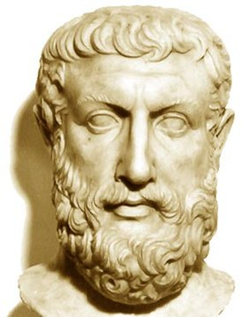
Parmenides - the philosopher who expressed the idea of existence for the first time in philosophy. He called necessity the eternal, indestructible divine, truth, destiny, Cosmos. Therefore, nothing in the world can change suddenly, accidentally. He showed that only existence exists, and non-existence does not exist at all.
According to Parmenides, existence is neither created nor destroyed, it exists forever. He is unchangeable, perfect. Parmenides treated existence not as a specific object or event, but as a general existence. According to him, existence is known to man only through intelligence. The sense organs cannot perceive it

Slide 6
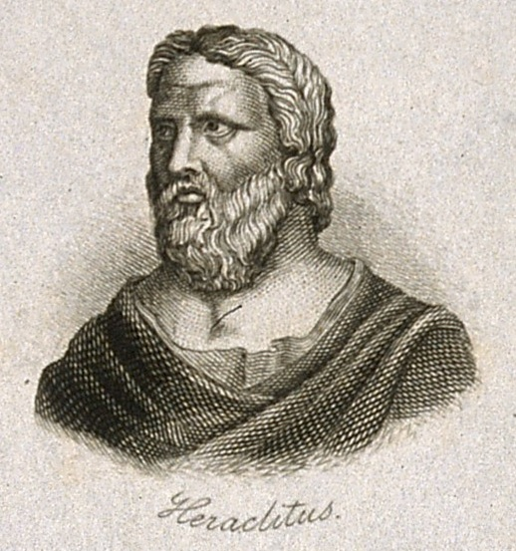
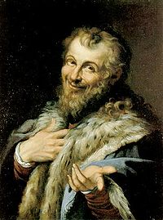
Heraclitus of Ephesus , the world was not created by any God or man, it is a living fire that always exists. This fire is always in motion, burning and dying from time to time.
Democritus believed that existence (the world) consists of indivisible small particles - atoms and space.

Slide 7
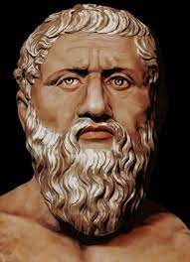
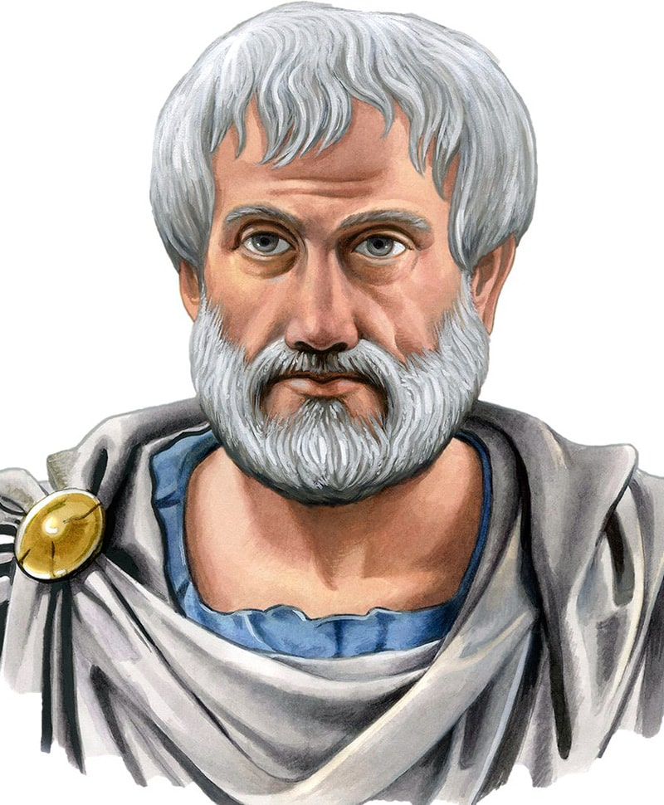
In ancient philosophy , Plato's system explained existence in a unique way. According to this teaching, the world of eternal and unchanging ideas is the basis of existence. The concrete objects and objects that surround us are temporary and determined by eternal ideas.
Aristotle , existence is a living substance (substance means the basis of any existence). It has the following principles; an entity is material and independent, has a certain structure (i.e. an active form), has an origin (cause) and serves a certain purpose.

Slide 8
Four forms of existence:
1. Existence of objects and processes - existence of individual objects, processes and situations in nature; the existence of nature taken as a whole; the presence of man-made objects and processes. The latter are also called the existence of "second nature". The existence of individual objects, processes and situations in nature is characterized by the fact that they arose before man and exist independently of him.
2. Human existence - Human existence is characterized by being extremely specific. So, he belongs to both worlds of existence (material and spiritual). On the one hand, the human body is subject to material, natural and biological laws.
3. Spiritual (ideal) existence - Another form of existence is spiritual existence. It is also internally complex, divided into two parts: subjective spiritual existence and objectified spiritual existence. The first includes the inner psychic world of a person. It includes the products and levels of consciousness of each individual.
4. Social existence - It includes numerous relationships between people in society. It includes identities, social associations and various other relationships in society.

Slide 9
THANKS FOR ATTENTİON

